Slide 1
SOLID Principles - Recap
S - Single Responsibility Principle
O - Open Close Principle
L - Liskov Substitution Principle
I - Interface Segregation Principle
D - Dependency Inversion Principle
Notes:
Proposed by Robert C. Martin – Uncle Bob around 2000, clean code blog
The acronym - Michael Feathers
The reason behind them?
Why C++? A better C.
Why SOLID? OOP Language wont suffice, apparently – flexible, maintainable, understandable software design,

Slide 2
SOLID Principles and Software Quality
user perspective: should work as intended and fast, feature rich, intuitive etc.
developer perspective: should be easy to maintain, test, extend, time to market, costs etc.
Notes:
functionality and performance related aspects are not the only quality criteria for software but remain the most important for the end user
developer criteria influences user ones and vice versa
Balance
Defer

Slide 3
FIFA 18 Career – New Transfer System
New Transfer System - a complete redesign of the existing one from new backend AI to new UI transfer flows for the user, featuring live, in scene club and player negotiations
Notes:
Introduce Career mode:
Manager of one team for 15 consecutive seasons
One of the responsibilities is to manage transfers

Slide 4
Building Career’s New Transfer System - Challenges
a lot of legacy code - 8+ years of continuous development
outdated documentation
forgotten features & requirements
no automated regression testing
AND a huge responsibility towards our fans
Notes:
Huge responsibility:
- So nothing new, only rewriting the existing transfer system – it must be good or else we risk disappointing our users
Not break anything else.
Close to no documentation – reverse engineering
Conclusions: very difficult assignment and relying on SOLID paid out.

Slide 5
Building Career’s New Transfer System – The Codebase
Files ~ 1800
LOC ~ 600000

Slide 6
SOLID Career - Cases
Negotiations – transfer offer evaluation between different types of seller and buyer entities (AI, delegate, user, club, player etc.)
Data Access Layer – data access infrastructure built over our existing database, decoupling transfer logic and algorithms from data source
Notes:
Negotiation – describe the idea around negotiations: player transfer market

Slide 7
Negotiations – Legacy implementation
Implemented across four (4) “manager” classes in charge with all the transfer functionality, not only negotiations, counting ~10000 LOC:
class TransferManger;
class TransferActivityManager;
class TransferAcceptanceManager;
class TransferListingManager;
Notes:
- Mention negotiation bug,

Slide 8
Negotiations – Legacy implementation
Insufficient Model – one class to keep all the offers and counter offers, various offer states being guessed at runtime rather then being kept inside the mode
Notes:
- Mention negotiation bug,

Slide 9
Negotiations – Legacy implementation SOLID Analysis
S – Single Responsibility Principle – breaker!
Four “manager” classes responsible for negotiations logic (seller logic, buyer logic, offer, counteroffer etc.) along other transfer related functionality like transfer listing, team shortlists etc.
class TransferManager : public IManager, public FCEI::ISaveLoadObject {
public:
void CreateOfferForPlayer(...);
void ForceTransfer(...);
void AddTransferNews(...);
Notes:
-Introduce “legacy” functionality and its limitations, eventually legacy screens and screen flows for negotiating (user part)
-talk about limitations on the backend
- SOLID violations

Slide 10
Negotiations – Legacy implementation SOLID Analysis
O – Open Close Principle – breaker!
Any changes to negotiation related functionality, e.g. new seller functionality meant changing more than one Transfer*Manager class
Notes:
-Introduce “legacy” functionality and its limitations, eventually legacy screens and screen flows for negotiating (user part)
-talk about limitations on the backend
- SOLID violations

Slide 11
Negotiations – Legacy implementation SOLID Analysis
L – Liskov Substitution Principle – breaker!
No abstractions present ☺
Notes:
-Introduce “legacy” functionality and its limitations, eventually legacy screens and screen flows for negotiating (user part)
-talk about limitations on the backend
- SOLID violations

Slide 12
Negotiations – Legacy implementation SOLID Analysis
I – Interface Segregation Principle – breaker!
All four managers offer public methods to more or less different transfer functionality
class TransferActivityManager : public IManager {
public:
void ProcessShortlist(…);
void FillPossibleReplacementsYoungTalent(…);
bool IsNumberOfOffersExceeded(…);
Notes:
-Introduce “legacy” functionality and its limitations, eventually legacy screens and screen flows for negotiating (user part)
-talk about limitations on the backend
- SOLID violations

Slide 13
Negotiations – Legacy implementation SOLID Analysis
D – Dependency Inversion Principle – breaker!
All four managers reference directly one or more of the other one. No interfaces present
void TransferActivityManager::ProcessShortlist(Shortlist* shortlist) {
…
if ((userTeamId != buyingTeamId) && mHub->Get<TransferAcceptanceManager >()->IsCurrentlyNegotiating(transferListPlayerId, userTeamId)) …
Notes:
-Introduce “legacy” functionality and its limitations, eventually legacy screens and screen flows for negotiating (user part)
-talk about limitations on the backend
- SOLID violations

Slide 14
Negotiations – New Design
Dedicated Buyer and Seller interfaces with implemented for each particular case: club/seller/user/AI
Extensive model mirroring real life complexity behind transfer negotiations and supporting detailed features on the UI side - rich, comprehensive information in Transfer HUB and scene widget – and complex scenarios for scene subtitles
Notes:
-Introduce “legacy” functionality and its limitations, eventually legacy screens and screen flows for negotiating (user part)
-talk about limitations on the backend
- SOLID violations

Slide 15
Negotiations – New Design – Seller
class ISeller
{
public:
virtual void OnBuyerOffer() = 0;
virtual void OnBuyerAccepted() = 0;
virtual void OnBuyerRejected() = 0;
virtual ~ISeller() {};
};
Notes:
-Introduce “legacy” functionality and its limitations, eventually legacy screens and screen flows for negotiating (user part)
-talk about limitations on the backend
- SOLID violations

Slide 16
Negotiations – New Design – Buyer
class IBuyer
{
public:
virtual void OnSellerRequest() = 0;
virtual void OnSellerAccepted() = 0;
virtual void OnSellerRejected() = 0;
virtual ~IBuyer() {};
};
Notes:
-Introduce “legacy” functionality and its limitations, eventually legacy screens and screen flows for negotiating (user part)
-talk about limitations on the backend
- SOLID violations

Slide 17
Negotiations – New Design – Implementations
namespace ClubToClub {
class CpuSeller : public ISeller { ... };
class CpuBuyer : public IBuyer { ... };
class UserSeller : public ISeller { ... };
class UserBuyer : public IBuyer { ... };
}
Notes:
-Introduce “legacy” functionality and its limitations, eventually legacy screens and screen flows for negotiating (user part)
-talk about limitations on the backend
- SOLID violations

Slide 18
Negotiations – New Design – Implementations
namespace ClubToPlayer {
class CpuPlayerSeller : public ISeller { .. };
class CpuPlayerBuyer : public IBuyer { .. };
class UserPlayerSeller : public ISeller { .. };
class UserPlayerBuyer : public IBuyer { .. };
}
Notes:
-Introduce “legacy” functionality and its limitations, eventually legacy screens and screen flows for negotiating (user part)
-talk about limitations on the backend
- SOLID violations

Slide 19
Negotiations – New Design – Model – AI – AI Negotiations
struct PlayerOffer
{
int mPlayerWage;
int mContractLength;
TransferModel::PlayerTier mPlayerTier;
int mReleaseClause;
TransferModel::DateTime mDateTime;
};
Notes:
-Introduce “legacy” functionality and its limitations, eventually legacy screens and screen flows for negotiating (user part)
-talk about limitations on the backend
- SOLID violations

Slide 20
Negotiations – New Design Model – AI – User Negotation
struct UserPlayerOffer
{
int mPlayerWage;
int mContractLength;
TransferModel::PlayerTier mPlayerTier;
int mReleaseClause;
int mSignOnFee;
PlayerPerformanceBonus mPerformanceBonus;
TransferModel::DateTime mDateTime;
};
Notes:
-Introduce “legacy” functionality and its limitations, eventually legacy screens and screen flows for negotiating (user part)
-talk about limitations on the backend
- SOLID violations

Slide 21
Negotiations – New Design Model –Negotation
template <class OfferT, class RequestT>
class NegotiationBehavior
{
private:
ISeller * seller;
IBuyer * buyer;
eastl::vector<OfferT> offers;
eastl::vector<RequestT> requestss;
…
};
Notes:
-Introduce “legacy” functionality and its limitations, eventually legacy screens and screen flows for negotiating (user part)
-talk about limitations on the backend
- SOLID violations

Slide 22
Negotiations – New Design SOLID Analysis
S – Single Responsibility Principle
One class for each Buyer and for each Seller scenario – cpu/user/delegate/scene/club/player
class CpuPlayerSeller;
class UserClubBuyer;
Notes:
-Introduce “legacy” functionality and its limitations, eventually legacy screens and screen flows for negotiating (user part)
-talk about limitations on the backend
- SOLID violations

Slide 23
Negotiations – New Design SOLID Analysis
O – Open Close Principle
Adding new buyer and/or seller functionality won’t impact exiting one
class RonaldoCpuPlayerSeller;
class MidageRonaldoCpuPlayerSeller;
Notes:
-Introduce “legacy” functionality and its limitations, eventually legacy screens and screen flows for negotiating (user part)
-talk about limitations on the backend
- SOLID violations

Slide 24
Negotiations – New Design SOLID Analysis
L – Liskov Substitution Principle
Various seller and buyer implementations are interchangeable
NegotiationBehavior<UserPlayerOffer, UserPlayerRequest> n(
new CpuPlayerSeller(), //default AIPlayerSeller
new UserPlayerBuyer()
);
NegotiationBehavior<UserPlayerOffer, UserPlayerRequest> n(
new RonaldoPlayerSeller(), //special Ronaldo seller
new UserPlayerBuyer()
);
Notes:
-Introduce “legacy” functionality and its limitations, eventually legacy screens and screen flows for negotiating (user part)
-talk about limitations on the backend
- SOLID violations

Slide 25
Negotiations – New Design SOLID Analysis
I – Interface Segregation Principle
separate interfaces for buyer and seller used inside negotiation behavoris
class IBuyer;
class ISeller;
Notes:
-Introduce “legacy” functionality and its limitations, eventually legacy screens and screen flows for negotiating (user part)
-talk about limitations on the backend
- SOLID violations

Slide 26
Negotiations – New Design SOLID Analysis
D – Dependency Inversion Principle
Buyer and seller implementations rely on seller and buyer interfaces rather than on specific counterpart implementations
Notes:
-Introduce “legacy” functionality and its limitations, eventually legacy screens and screen flows for negotiating (user part)
-talk about limitations on the backend
- SOLID violations

Slide 27
Negotiations – New Design - Wins
Flexibility: permits infinite buyer and seller specialization, e.g. Ronaldo personalized ai player seller implementation – good for producers they can create diversity or delegate negotiation functionality
Containment - Isolated functionality and bugs – working on or fixing a bug inside one implementation won’t impact other ones (*except the ones derived from the affected implementation)
Notes:
-Introduce “legacy” functionality and its limitations, eventually legacy screens and screen flows for negotiating (user part)
-talk about limitations on the backend
- SOLID violations

Slide 28
Negotiations – New Design - Wins
Testing – run any AI seller or buyer through any number of predefined (or even generated) sell-buy scenarios
Parallel development - buyer and seller variations may be implemented at the same time by different engineers
Notes:
-Introduce “legacy” functionality and its limitations, eventually legacy screens and screen flows for negotiating (user part)
-talk about limitations on the backend
- SOLID violations

Slide 29
SOLID Career - Use Cases
Negotiations – transfer offer evaluation between different types of seller and buyer entities (AI, user, club, player etc.)
Data Access Layer – data access infrastructure built over our existing database, decoupling transfer logic and algorithms from data source
Notes:
Data Access Layer – what’s a Data Access Layer.
Why should it be a separate layer?

Slide 30
Data Access Layer – Legacy Implementation
One concrete, God class, acting as a wrapper over the DB, accessed by all other classes employed during the data intensive Career Functionality
class DataController;
500 public methods = Rigid, underperforming, near to zero optimization opportunities
Notes:
-Introduce “legacy” functionality and its limitations, eventually legacy screens and screen flows for negotiating (user part)
-talk about limitations on the backend
- SOLID violations

Slide 31
Data Access Layer – Legacy Implementation
class DataController
{
public:
…
void FillLeagueIds(...) const;
void FillAllTransferOfferList(...) const;
void UpdatePlayerGrowthInfo(...) const;
void WriteCalendarData(...) const;
void InsertFutureFee(...) const;
…
};
Notes:
-Introduce “legacy” functionality and its limitations, eventually legacy screens and screen flows for negotiating (user part)
-talk about limitations on the backend
- SOLID violations

Slide 32
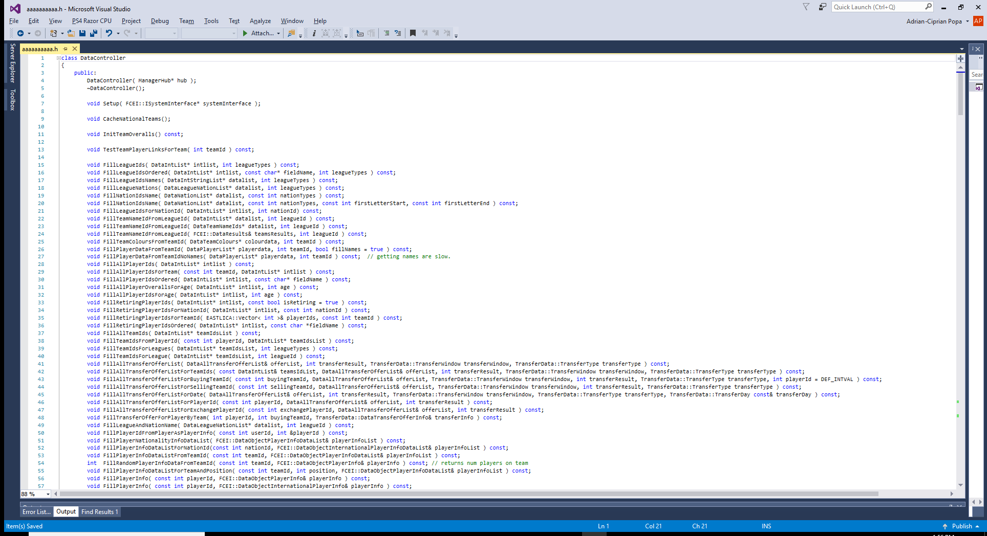

Slide 33
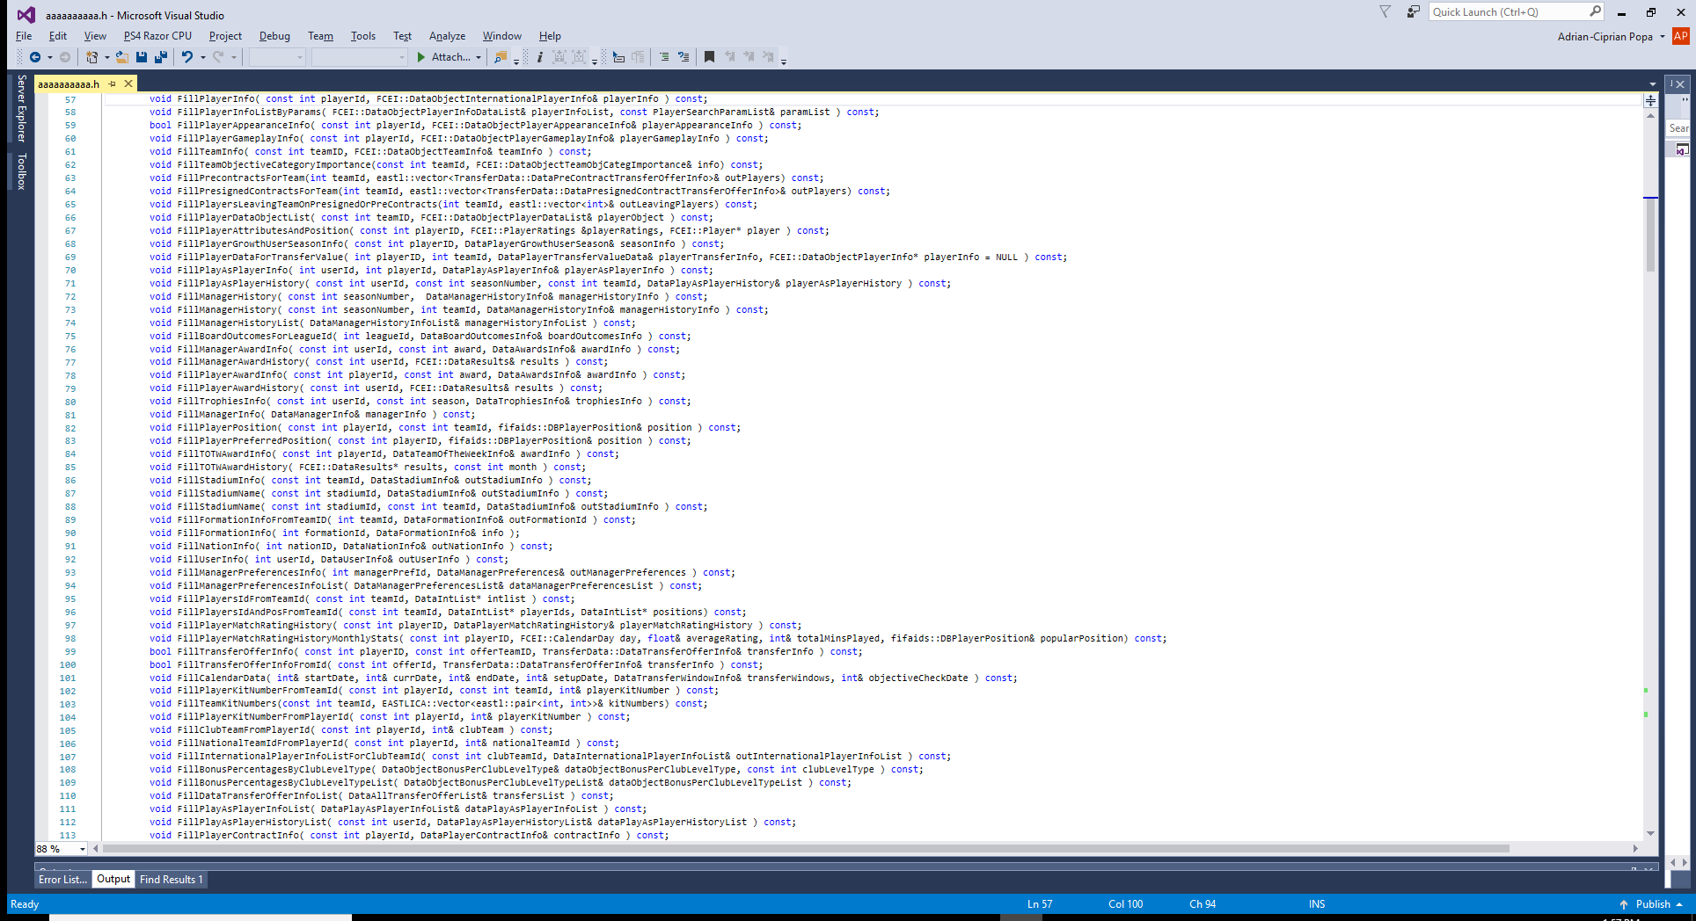

Slide 34
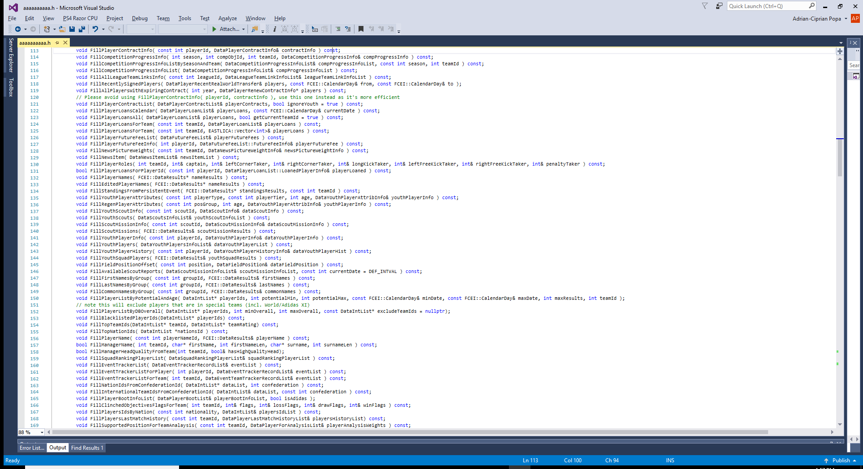

Slide 35
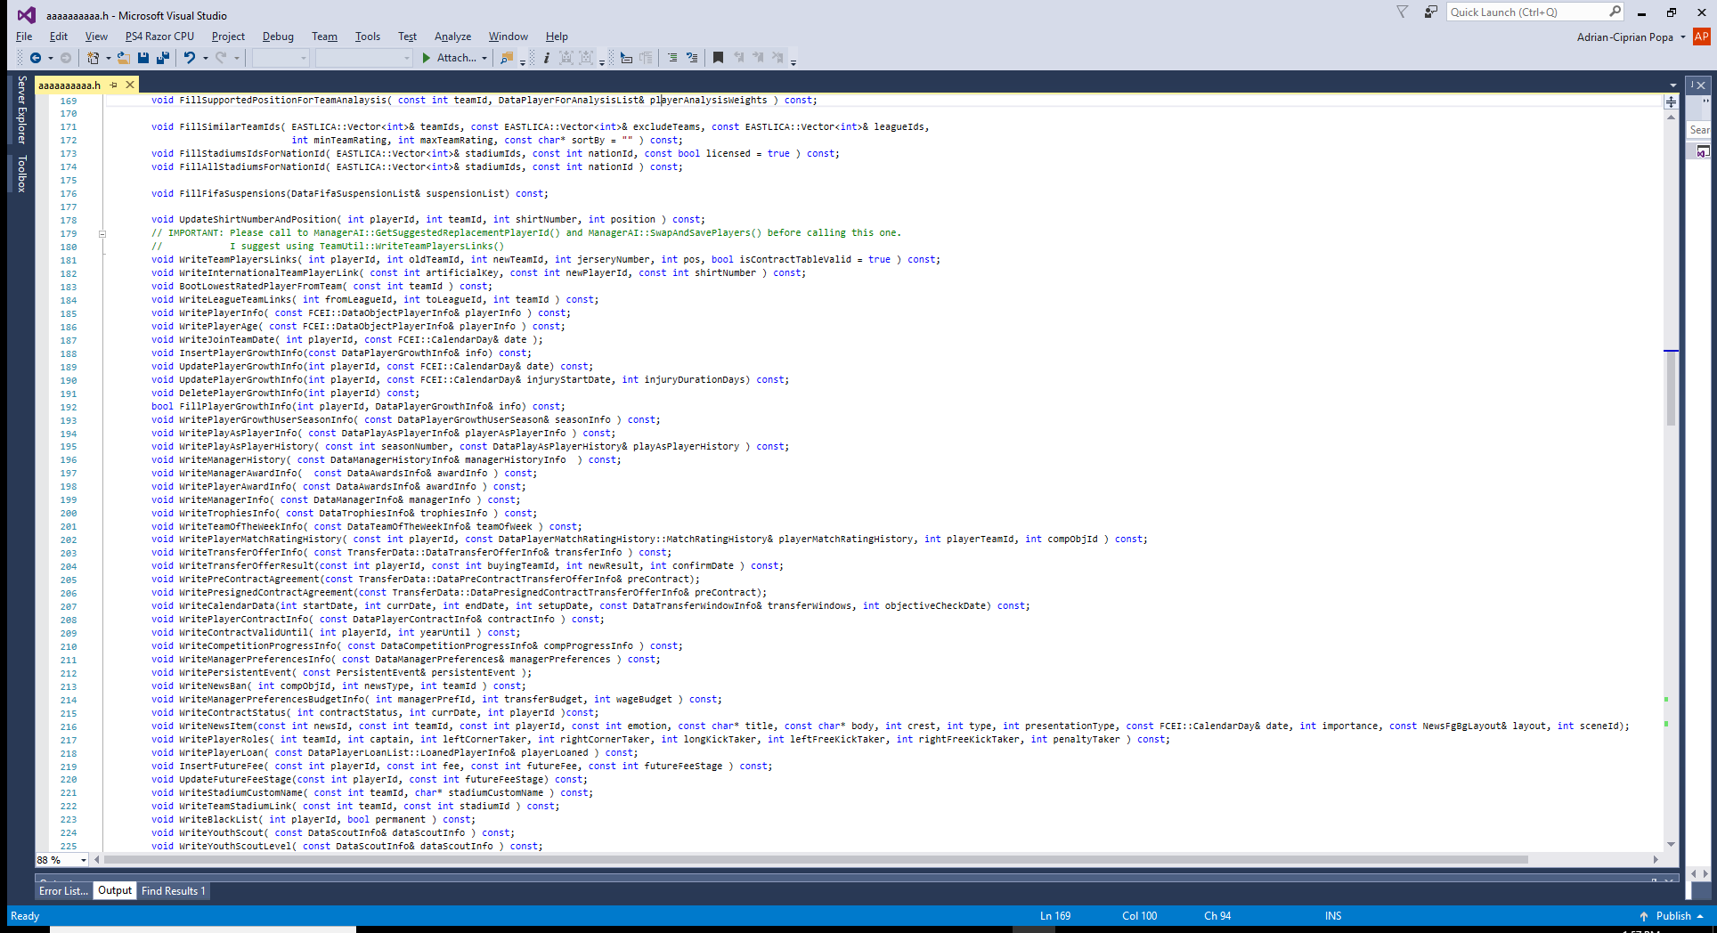

Slide 36
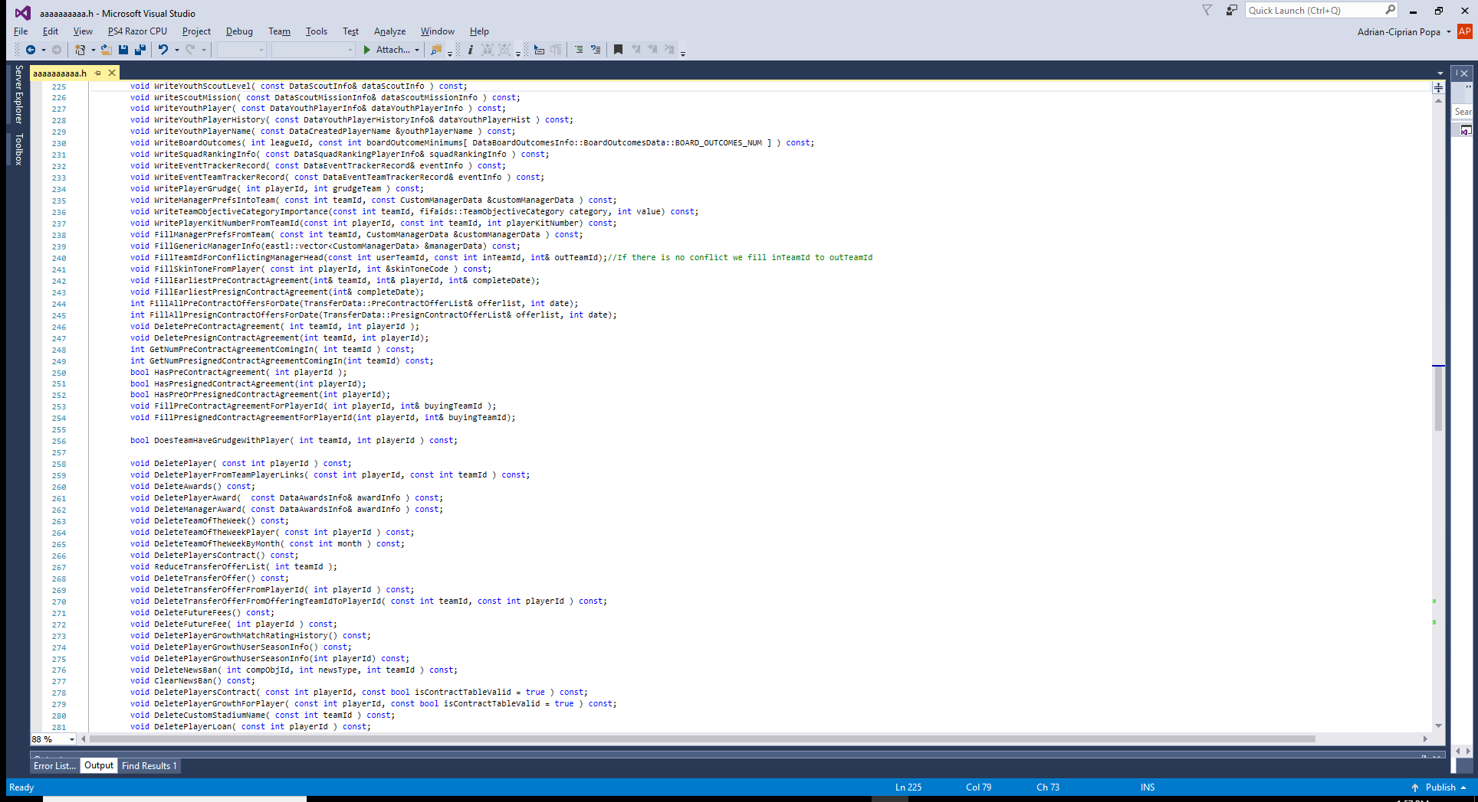

Slide 37
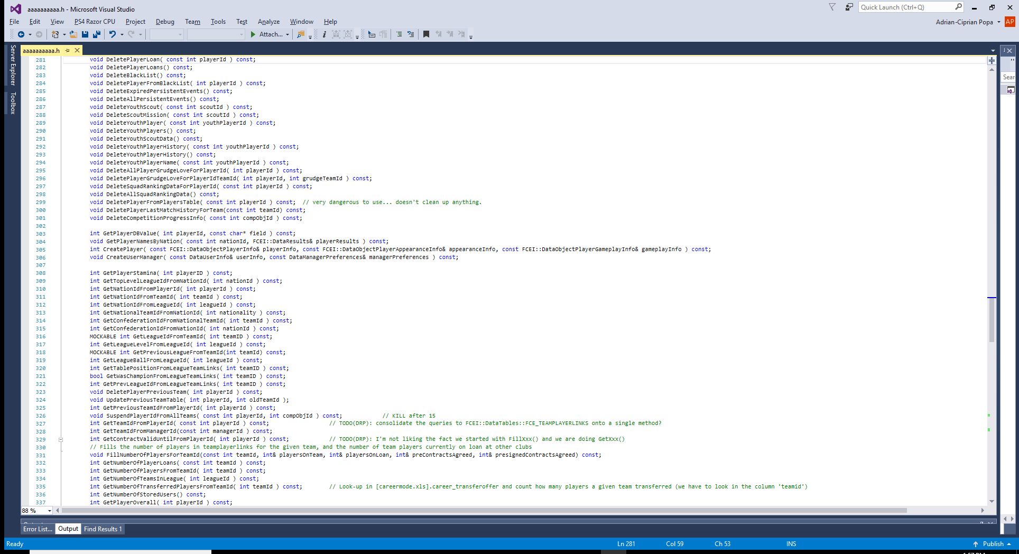

Slide 38
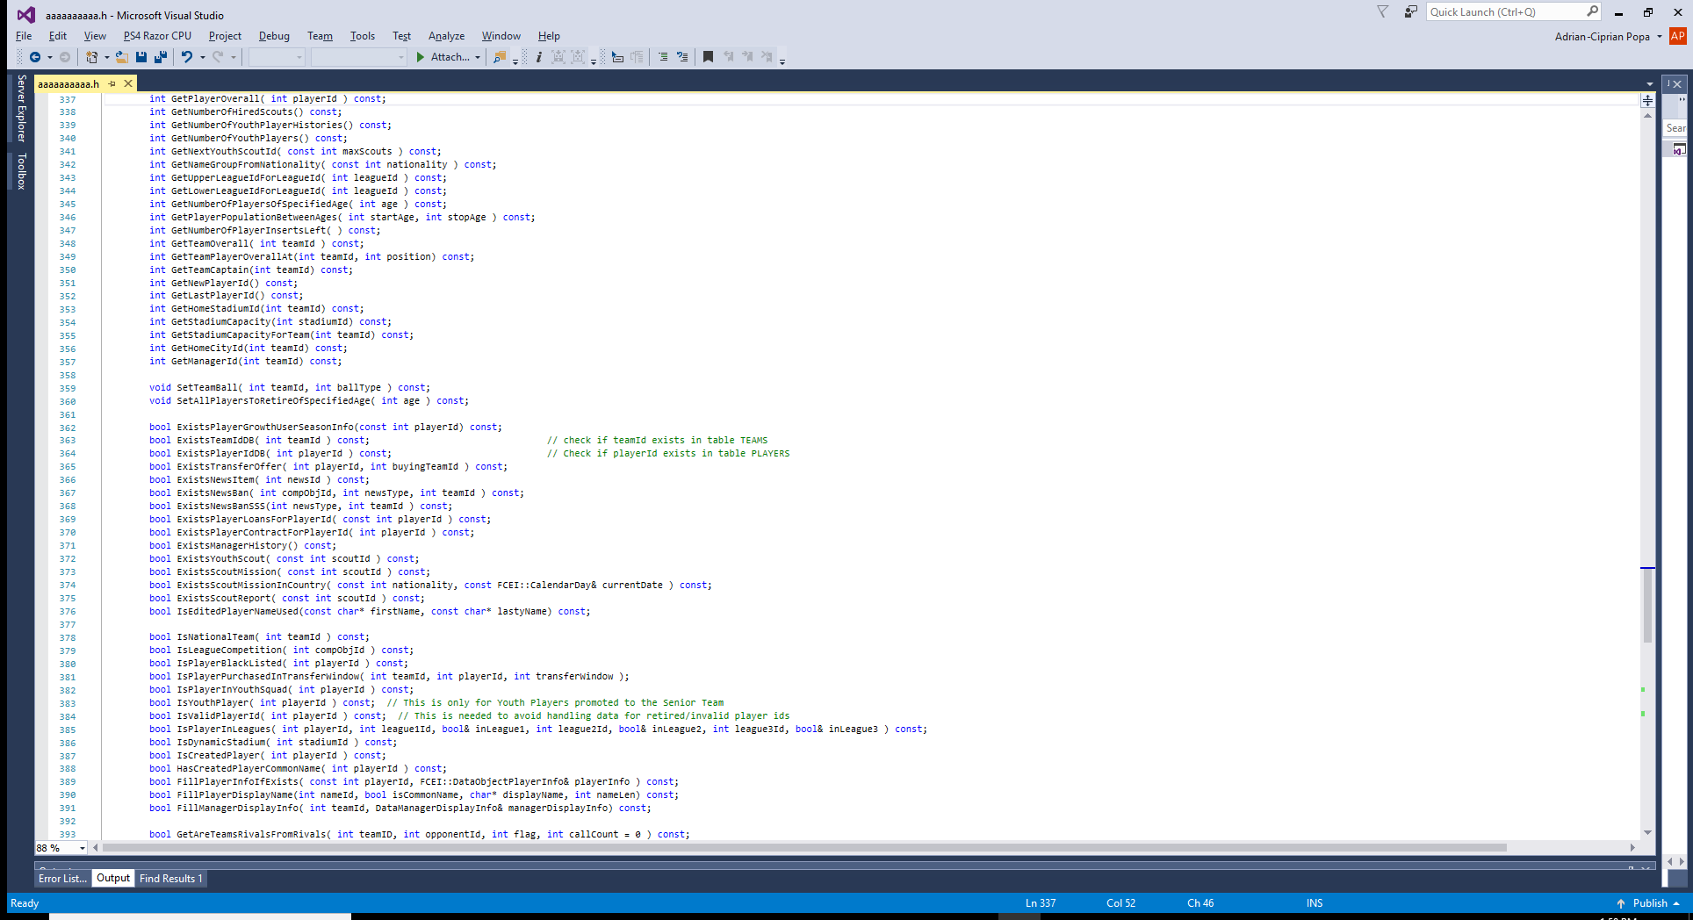

Slide 39
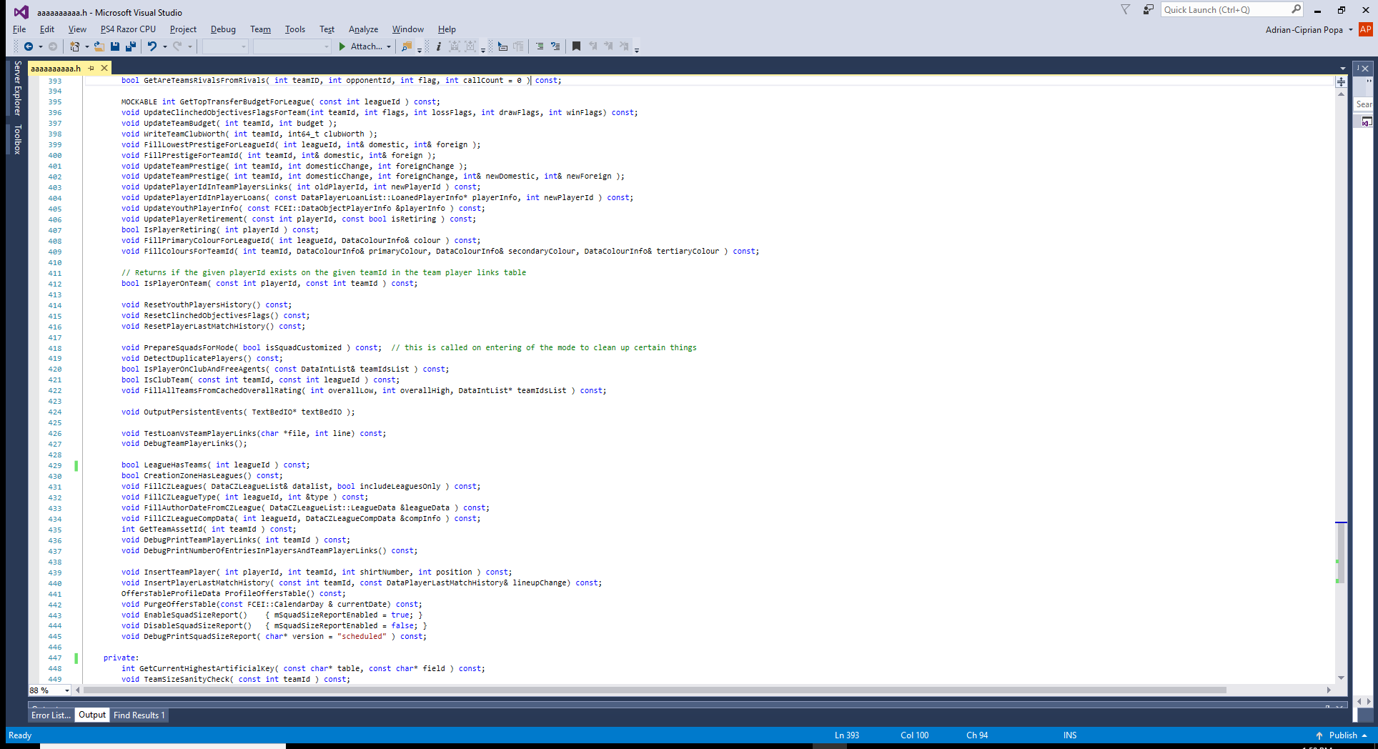

Slide 40
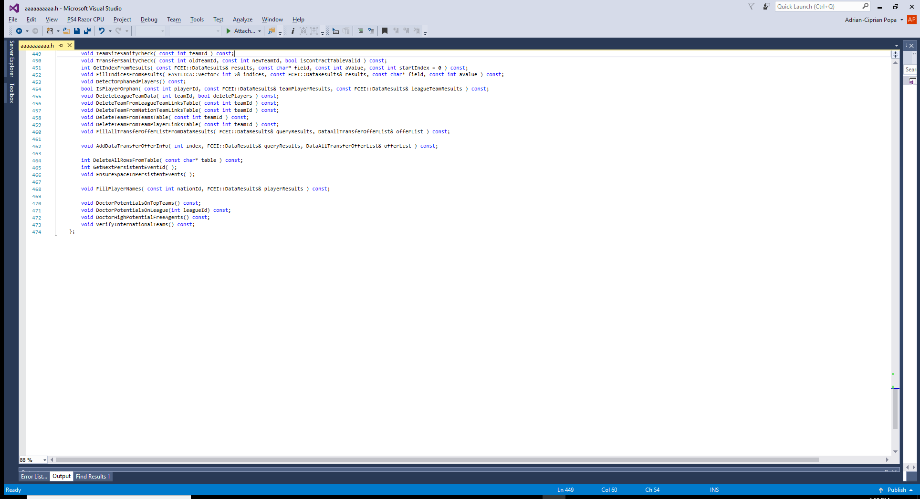

Slide 41
Data Access Layer – Legacy implementation SOLID Analysis
S – Single Responsibility Principle – breaker!
500 (five hundred) of these:
void FillAllTransferOfferList(...) const;
void UpdatePlayerGrowthInfo(...) const;
void WriteCalendarData(...) const;
void InsertFutureFee(...) const;
Notes:
-Introduce “legacy” functionality and its limitations, eventually legacy screens and screen flows for negotiating (user part)
-talk about limitations on the backend
- SOLID violations

Slide 42
Data Access Layer – Legacy implementation SOLID Analysis
O – Open Close Principle – breaker!
Any change must be operated inside the single God class and may affect all its clients. Closing DataController is impossible.
Notes:
-Introduce “legacy” functionality and its limitations, eventually legacy screens and screen flows for negotiating (user part)
-talk about limitations on the backend
- SOLID violations

Slide 43
Data Access Layer – Legacy implementation SOLID Analysis
L – Liskov Substitution Principle – breaker!
No abstractions present ☺
Notes:
-Introduce “legacy” functionality and its limitations, eventually legacy screens and screen flows for negotiating (user part)
-talk about limitations on the backend
- SOLID violations

Slide 44
Data Access Layer – Legacy implementation SOLID Analysis
I – Interface Segregation Principle – breaker!
500 …
Notes:
-Introduce “legacy” functionality and its limitations, eventually legacy screens and screen flows for negotiating (user part)
-talk about limitations on the backend
- SOLID violations

Slide 45
Data Access Layer – Legacy implementation SOLID Analysis
D – Dependency Inversion Principle – breaker
Other classes accessing DB data need to rely on a concrete class and thus on its implementation rather than on an abstract data source
Notes:
-Introduce “legacy” functionality and its limitations, eventually legacy screens and screen flows for negotiating (user part)
-talk about limitations on the backend
- SOLID violations

Slide 46
Data Access Layer – New Design
Decoupled data related concepts - Model, Algorithms and Data Source:
Created a concrete Model for all entities used inside transfer logic (Team, Player, Contract etc.)
Rewritten all transfer Logic and Algorithms to use the Model rather than DataController
Created a Data Source abstraction relying on Data Access
Notes:
-Introduce “legacy” functionality and its limitations, eventually legacy screens and screen flows for negotiating (user part)
-talk about limitations on the backend
- SOLID violations

Slide 47
Data Access Layer – New Design - Model
namespace TransferModel {
struct Player {
int mId;
int mBirthDate;
int mOverall;
int mPotential;
int mNationality;
eastl::array<fifaids::DBPlayerPosition, fifaids::NUM_POSITIONS> mPreferredPositions;
...
};
}
Notes:
-Introduce “legacy” functionality and its limitations, eventually legacy screens and screen flows for negotiating (user part)
-talk about limitations on the backend
- SOLID violations

Slide 48
Data Access Layer – New Design - Algos
class TransferTeamAnalysis
{
public:
TransferModel::TeamScore GetTeamScore(
const TransferModel::TeamFull& team,
const TransferModel::Formation& formation,
const eastl::vector<TransferModel::SoldPlayerEntry>&
soldPlayers,
const eastl::hash_map<int, bool>& playerGrowthPeak);
…
};
Notes:
-Introduce “legacy” functionality and its limitations, eventually legacy screens and screen flows for negotiating (user part)
-talk about limitations on the backend
- SOLID violations

Slide 49
Data Access Layer – New Design – Data Access Objects Interfaces
class IPlayerDAO
{
public:
virtual TransferModel::Player GetPlayer(int playerId) const = 0;
virtual TransferModel::PlayerWithTeam GetPlayerWithTeam(int playerId) const = 0;
virtual TransferModel::PlayerExtraInfo GetPlayerExtraInfo(int playerId, int teamId) const = 0;
virtual void FillAllPlayerIds(eastl::vector<int>& playerIds) = 0;
virtual void FillAllPlayers(eastl::vector<TransferModel::PlayerWithTeam>& players, unsigned int extraReserveCount = 0) = 0;
};
Notes:
-Introduce “legacy” functionality and its limitations, eventually legacy screens and screen flows for negotiating (user part)
-talk about limitations on the backend
- SOLID violations

Slide 50
Data Access Layer – New Design – Data Access Objects Implementations
class PlayerDAODBImpl : public IPlayerDAO { … };
class PlayerDAOCacheImpl : public IPlayerDAO { … };
Notes:
-Introduce “legacy” functionality and its limitations, eventually legacy screens and screen flows for negotiating (user part)
-talk about limitations on the backend
- SOLID violations

Slide 51
Data Access Layer – New Design SOLID Analysis
S – Single Responsibility Principle
Separate model class for each entity (model), separate data source interface for each data type, separate implementations for each data source type and model type: DB, memory cache, network etc.
class PlayerDAOCacheImpl;
class TeamDAODatabaseImpl;
Notes:
-Introduce “legacy” functionality and its limitations, eventually legacy screens and screen flows for negotiating (user part)
-talk about limitations on the backend
- SOLID violations

Slide 52
Data Access Layer – New Design SOLID Analysis
O – Open Close Principle
Adding future attributes to entities (e.g. player injury status) to model classes and DAO interfaces that extend the base ones or to complete separate ones
struct ExtendedPlayer : Player { … };
or
struct ExtendedPlayer { int id; int extendedAttribute; … };
Notes:
-Introduce “legacy” functionality and its limitations, eventually legacy screens and screen flows for negotiating (user part)
-talk about limitations on the backend
- SOLID violations

Slide 53
Data Access Layer – New Design SOLID Analysis
L – Liskov Substitution Principle
Various seller and buyer implementations are interchangeable
All transfer logic relying on DAO interfaces can work with any DAO Implementation
Notes:
-Introduce “legacy” functionality and its limitations, eventually legacy screens and screen flows for negotiating (user part)
-talk about limitations on the backend
- SOLID violations

Slide 54
Data Access Layer – New Design SOLID Analysis
I – Interface Segregation Principle
Separate DAO interface for each model entity:
class IPlayerDAO;
class IContractDAO;
class ITeamDAO;
Notes:
-Introduce “legacy” functionality and its limitations, eventually legacy screens and screen flows for negotiating (user part)
-talk about limitations on the backend
- SOLID violations

Slide 55
Data Access Layer – New Design SOLID Analysis
D – Dependency Inversion Principle
Transfer logic uses abstract data sources rather than concrete ones (DataController and DB)
Notes:
-Introduce “legacy” functionality and its limitations, eventually legacy screens and screen flows for negotiating (user part)
-talk about limitations on the backend
- SOLID violations

Slide 56
Negotiations – New Design - Wins
Decoupled Model and Algorithms from Data Sources means:
Clear algorithm requirements in terms of logic, input data and results
Unit Testing for all algorithms in all possible corner case scenarios
High reusability degree
Data source abstraction helped us work on optimizations relatively late relative to the project’s timeline and with 0 (zero) impact in transfer logic.
Notes:
-Introduce “legacy” functionality and its limitations, eventually legacy screens and screen flows for negotiating (user part)
-talk about limitations on the backend
- SOLID violations

Slide 57
Overall Project Wins
We delivered despite the fact the initial estimations were exceeded with a factor of 3-4x
Control: very low bug count compared to the change count: M 80k, D 40k, A 25k
Productivity: team started with 5 Software Engineers and ended up employing more than 8 people. Decoupling means a higher degree of parallel development
Notes:
On parallelism:
Separate classes

Slide 58
New Transfer System
The Outcome
Notes:
But how?

Slide 59
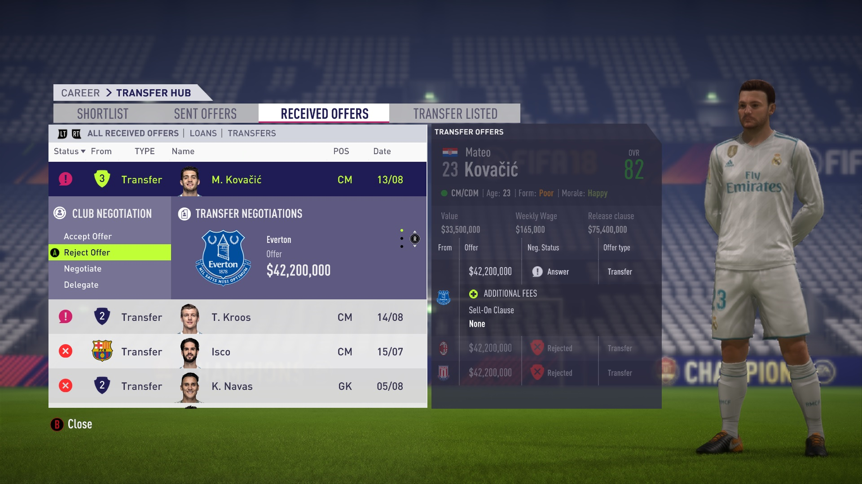
New Transfer System
The Outcome
Notes:
But how?

Slide 60
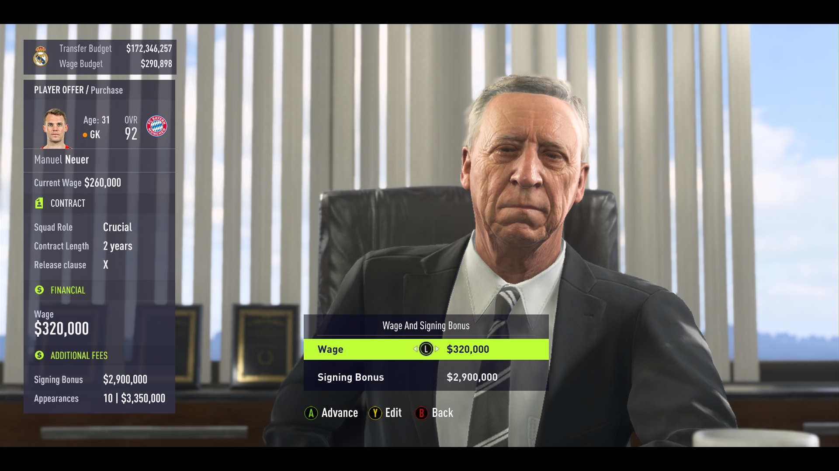
New Transfer System
The Outcome
Notes:
But how?

Slide 61
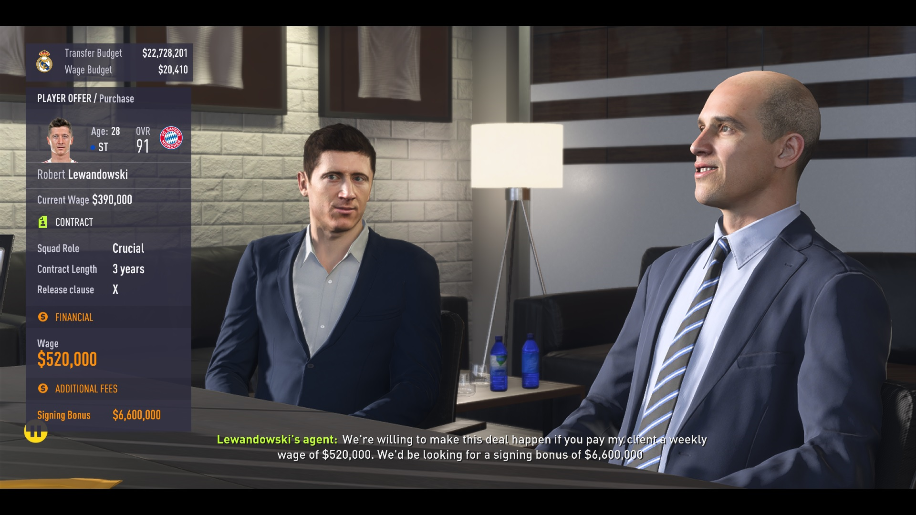
New Transfer System
The Outcome
Notes:
But how?

